Slide 1
Simulation and Experimental results

Slide 2
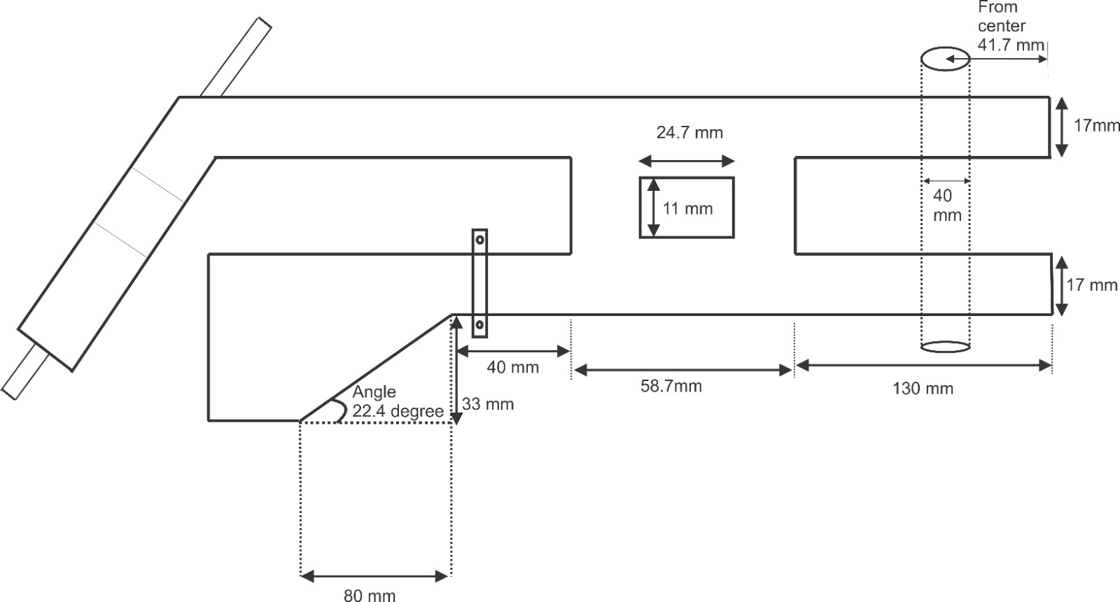
Our Designed Model

Slide 3
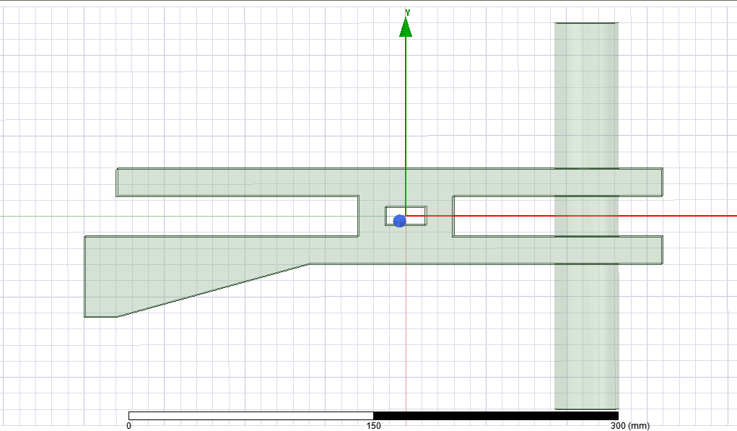
New designed model in Ansys
λo = 122 mm
λguide = 167 mm
Depends on Antenna
Less than λ_{guide} /4
Or, λ_{guide} + λ_{guide} /4
N*λ_{guide} /8
Greater than λ_{guide} /2

Slide 4
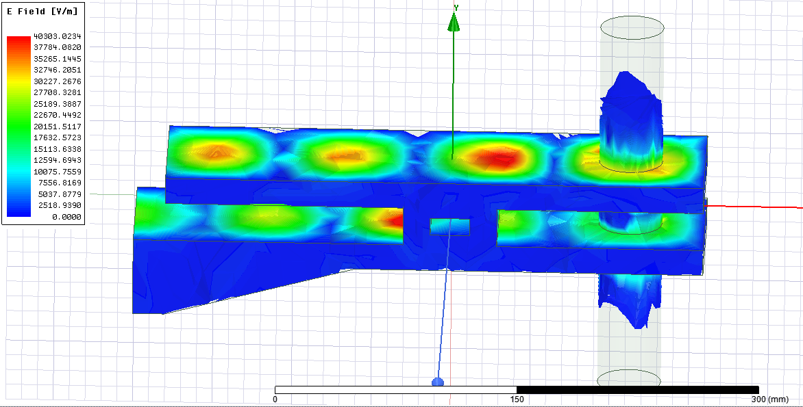
New designed model with E field
E field is maximum in expected region.

Slide 5
1KW
Magnetron
+
No
Safe?
Yes
Increase Power Level (200-500W)
Modify Model
No
Plasma?
Yes
Temp over 1500?
No
Yes
End

Slide 6
Experimental setup and Test Run

Slide 7
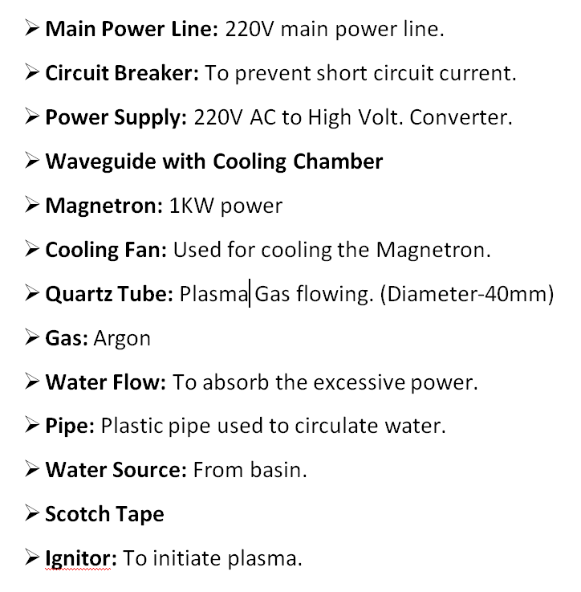
Necessary Connection and Equipments

Slide 8
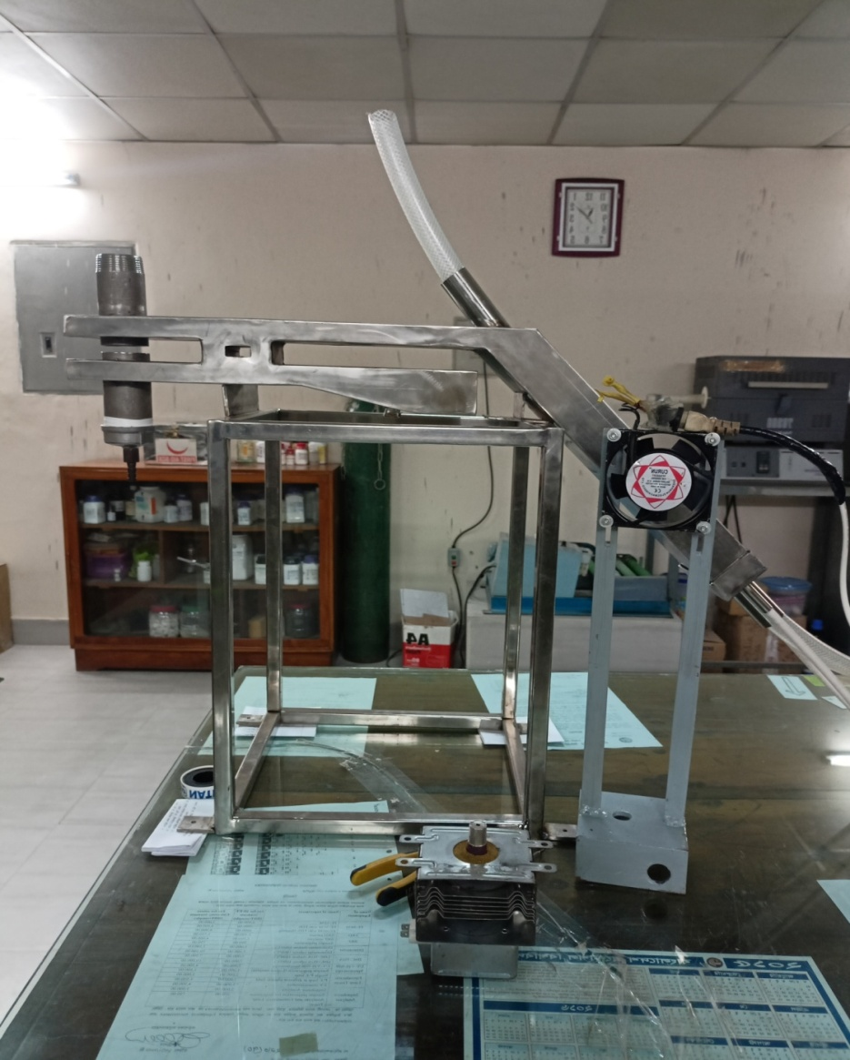
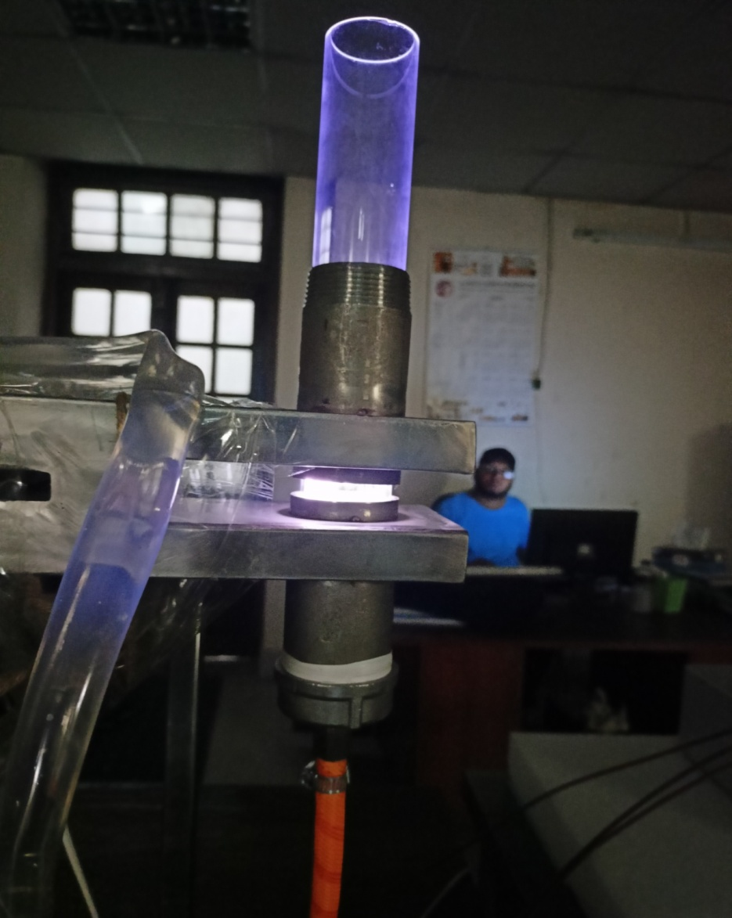
Date: 11th July, 2023
Gas Flow from Downside
(Gas inlet)

Slide 9
Upgraded Model for Testing

Slide 10
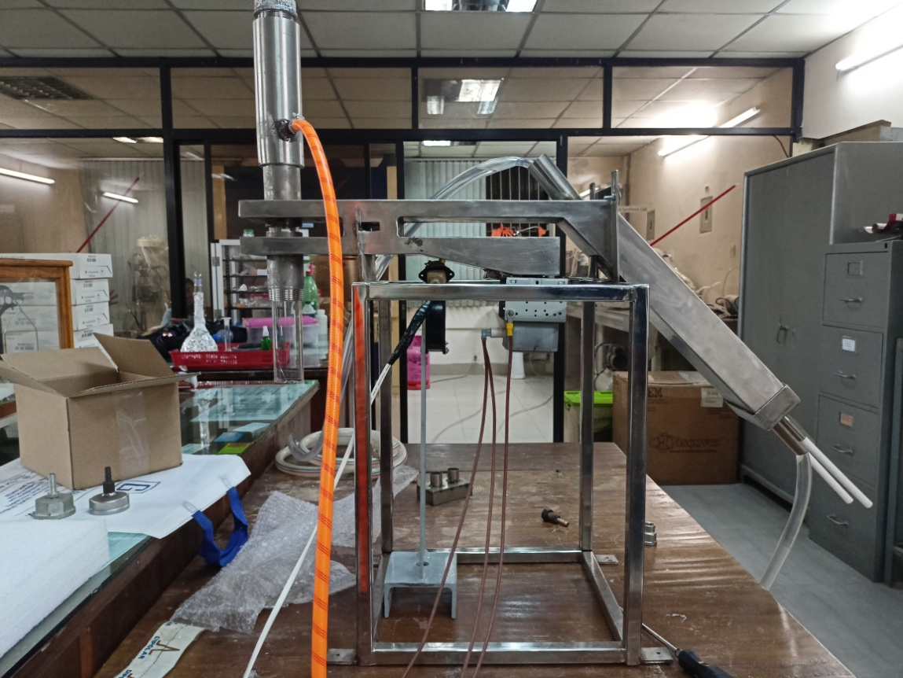
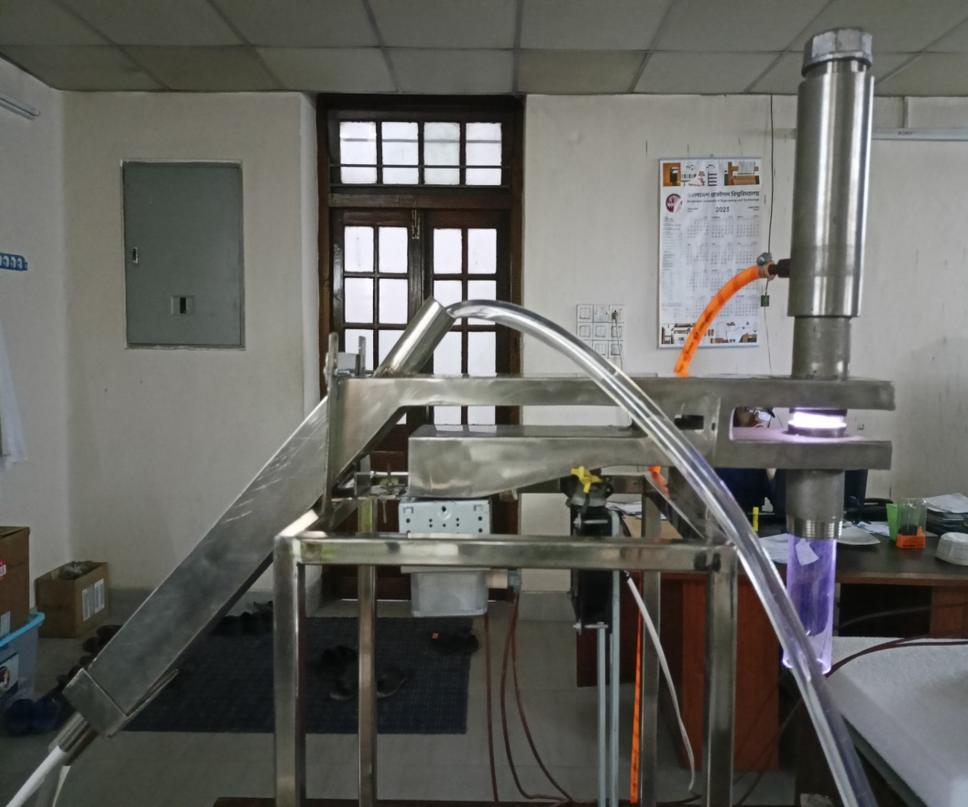
Date: 7th Aug,2023
Gas inlet from the upside
Gas outlet

Slide 11
Sample Testing

Slide 12
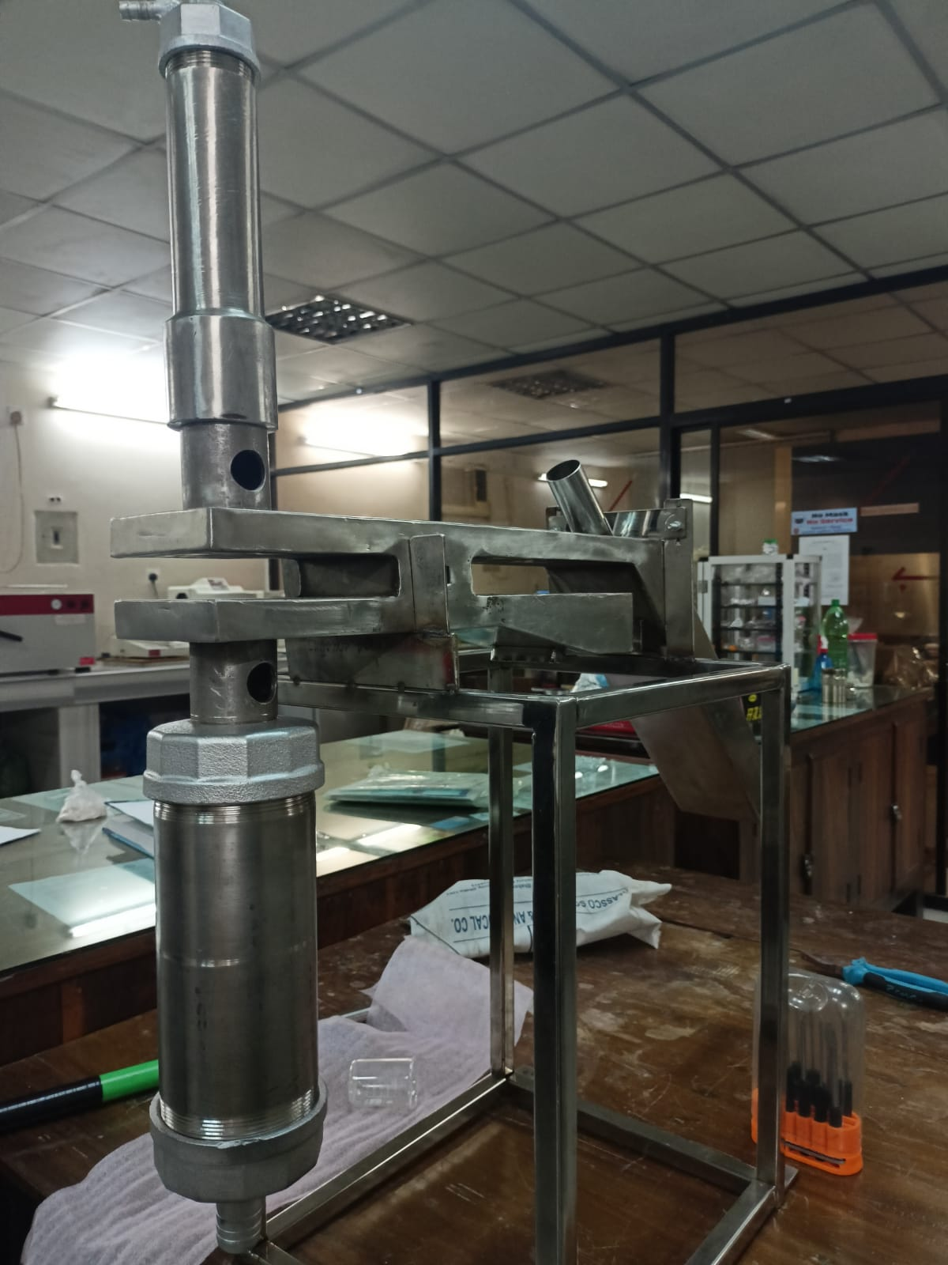
Setup for sample testing
Sample Feeder
Gas Inlet
Plasma Chamber
Sample Collector
Gas Outlet

Slide 13
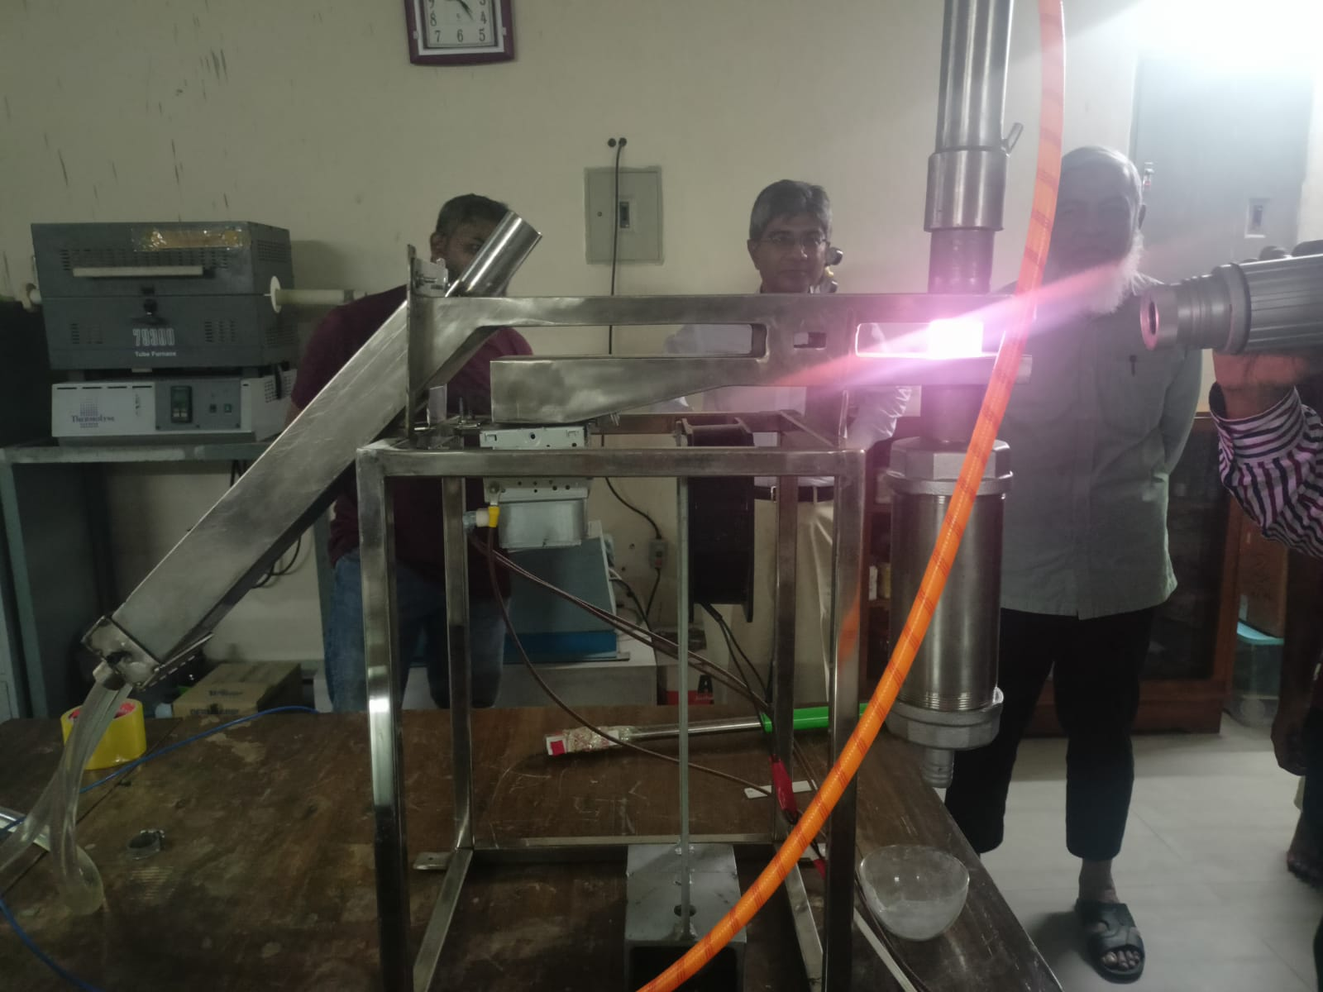
Test Day: 3rd Sep,2023

Slide 14
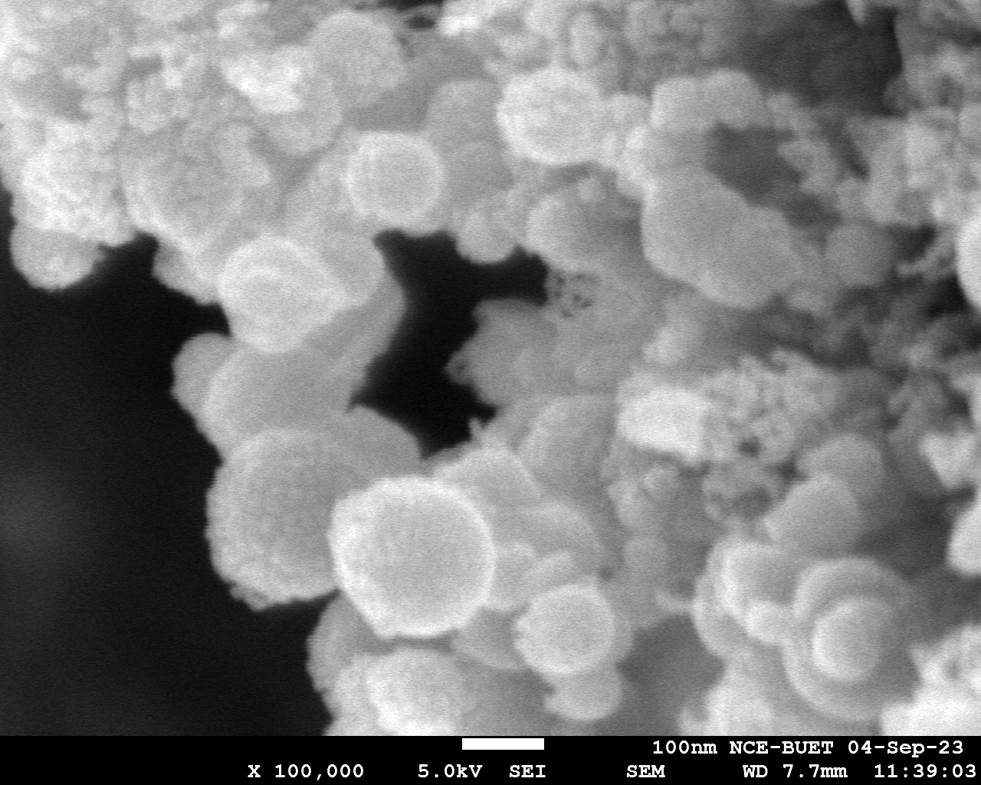
100nm
200nm
Sample Feeding : Uncontrolled
Sample collected: Quartz tube’s body and beaker

Slide 15
Test Day: 5th Sep, 2023

Slide 16
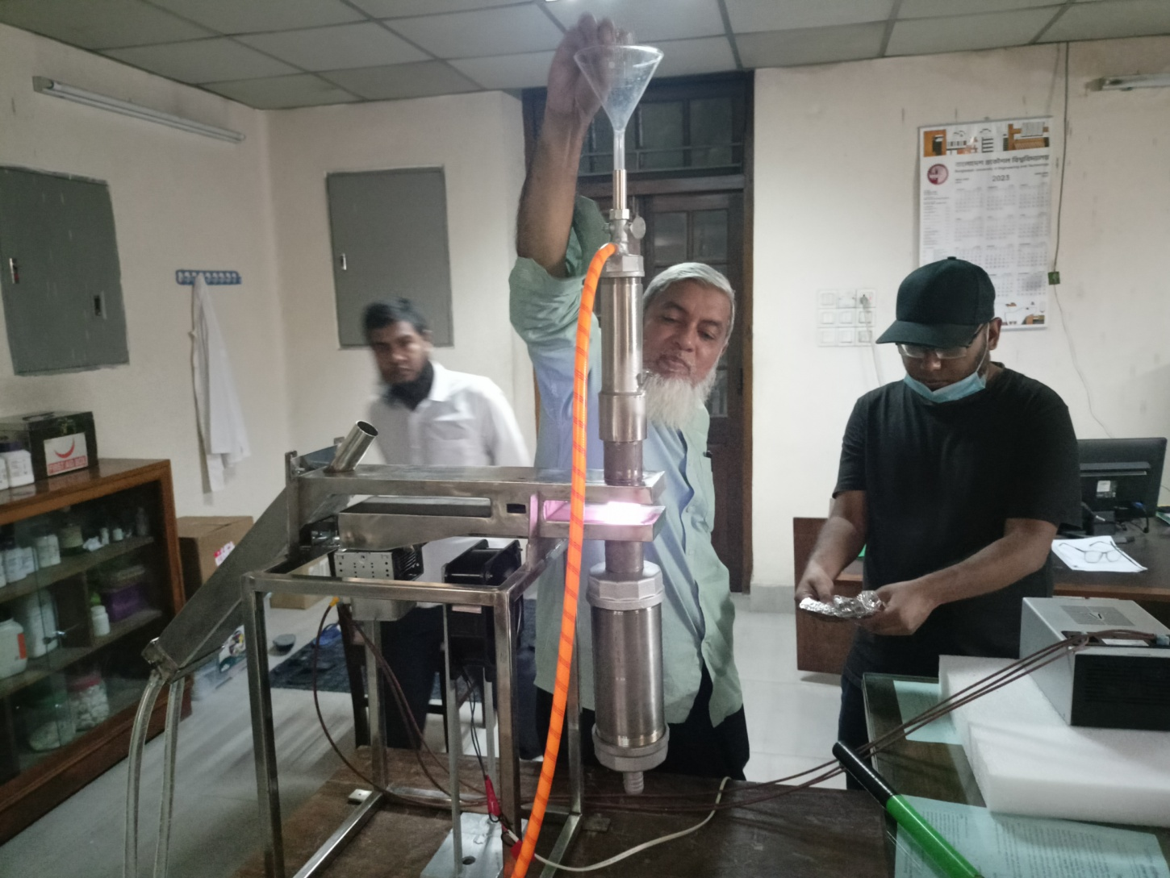
Feeding rate: 2-5 mg each time
Runtime: 15 minutes

Slide 17
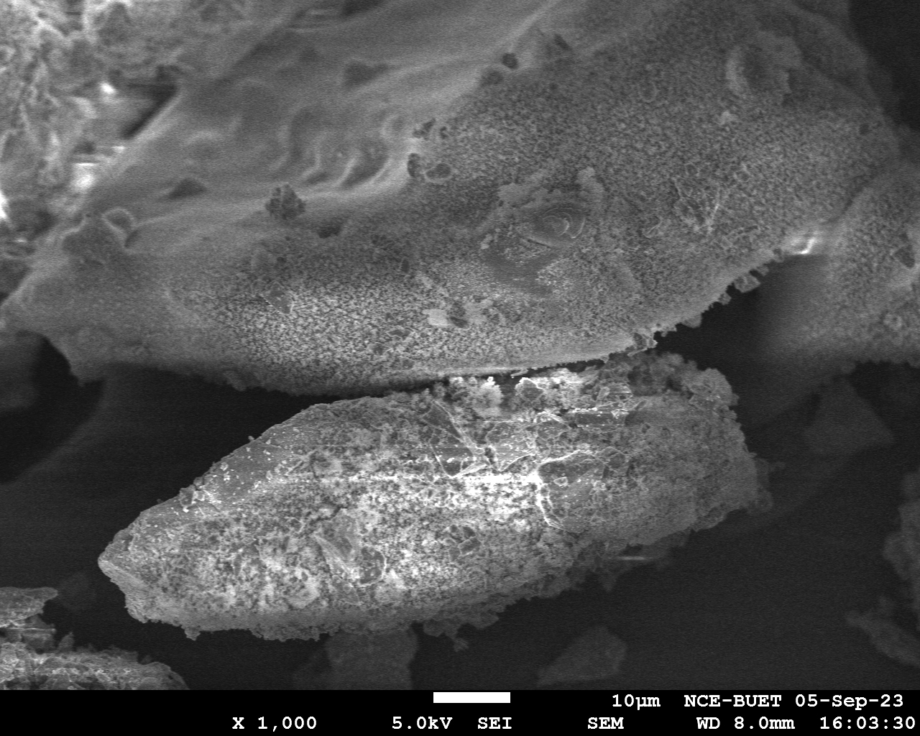
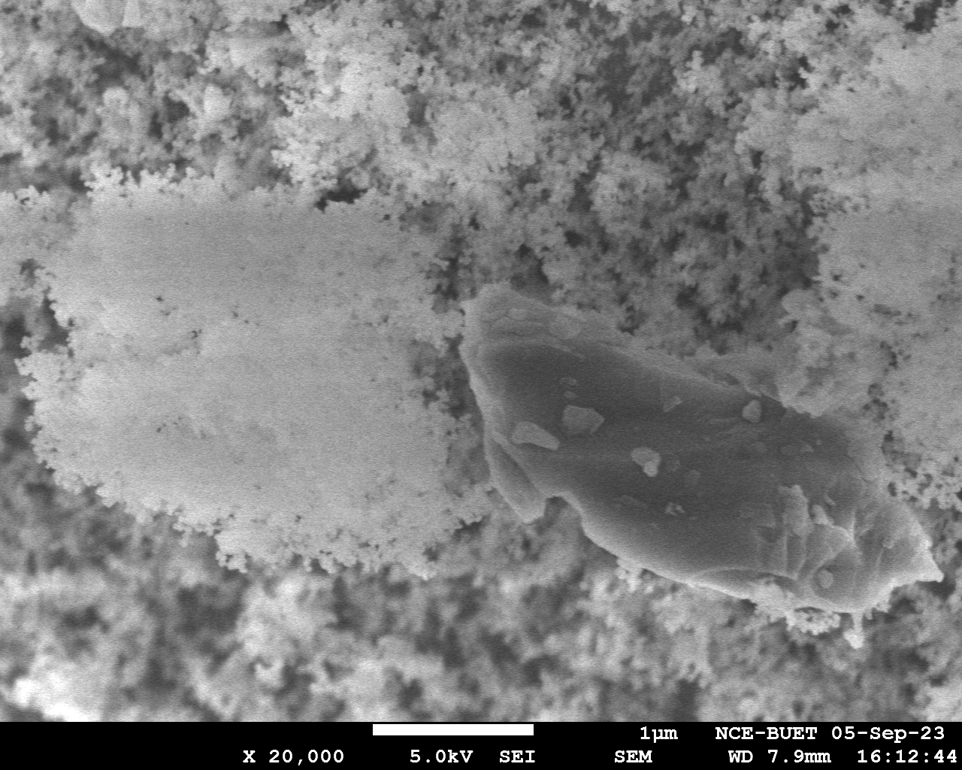
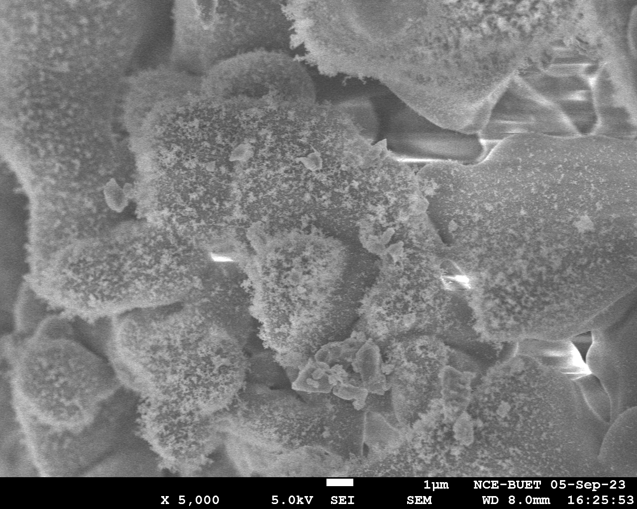
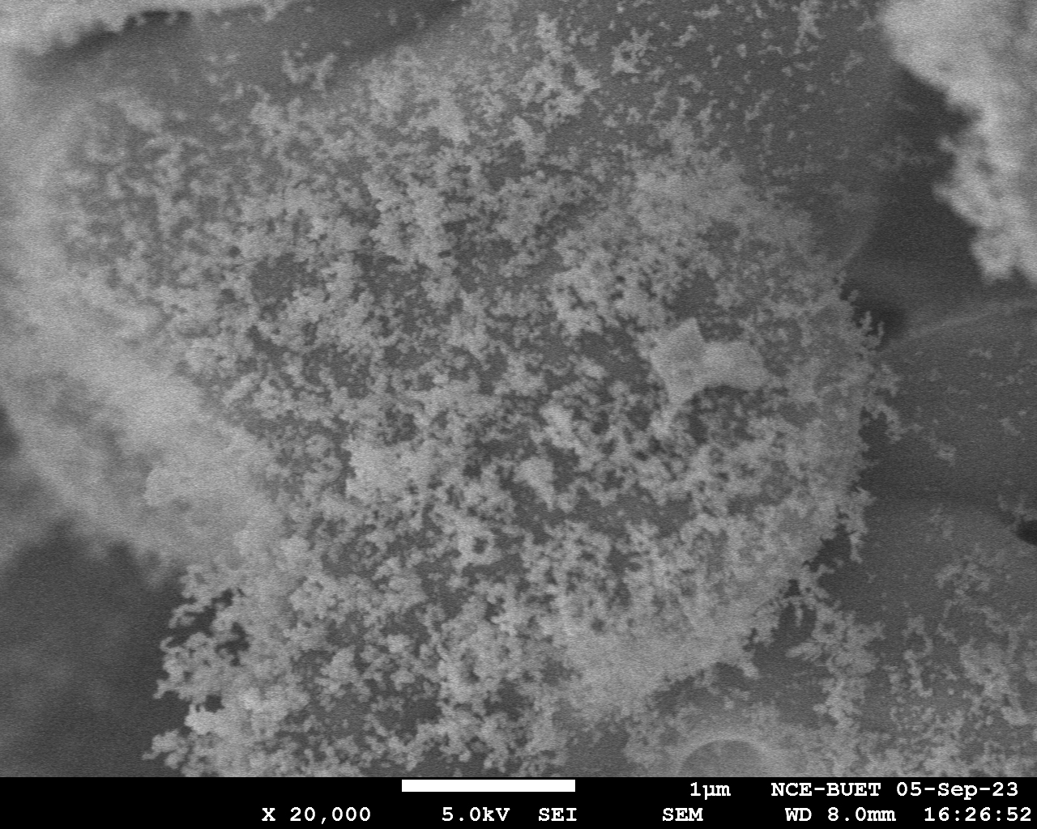

Slide 18
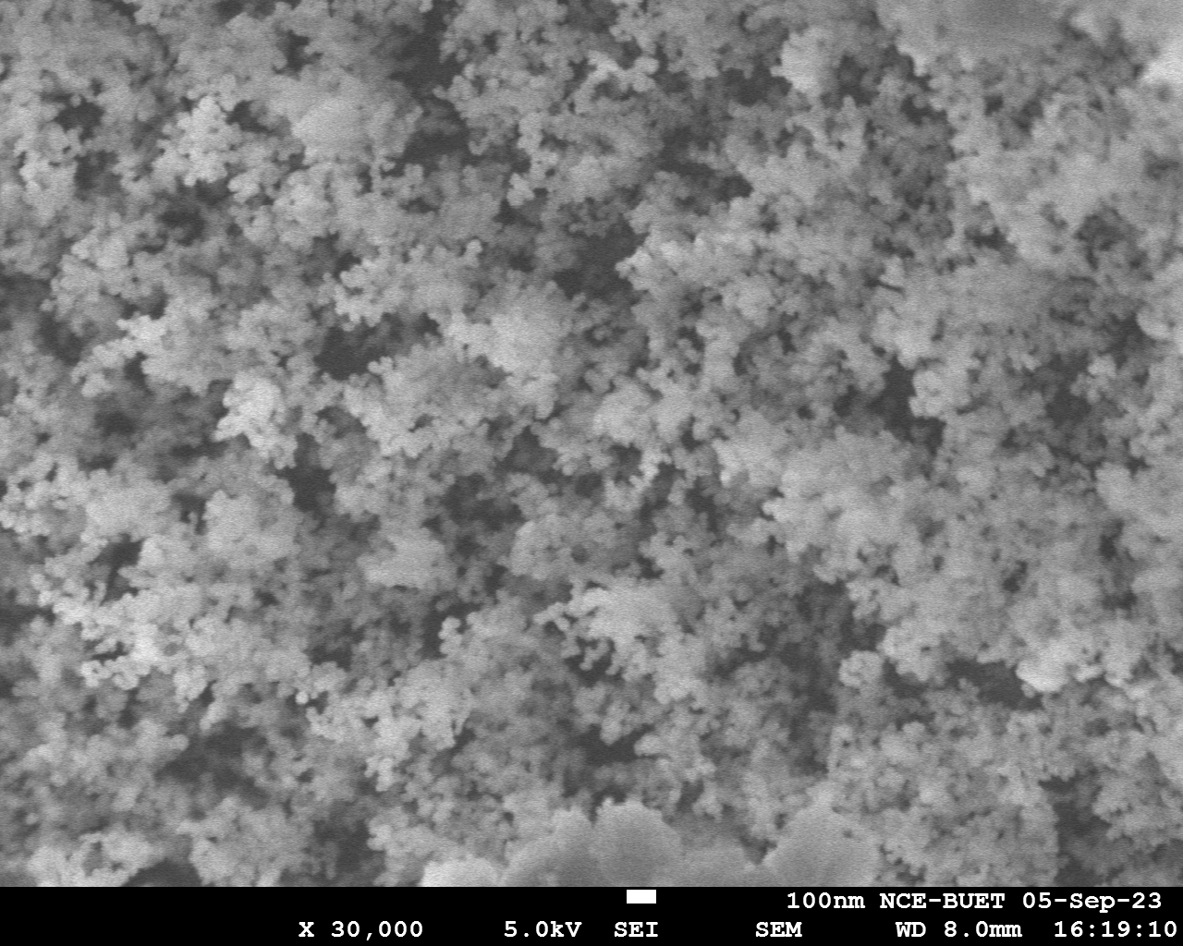
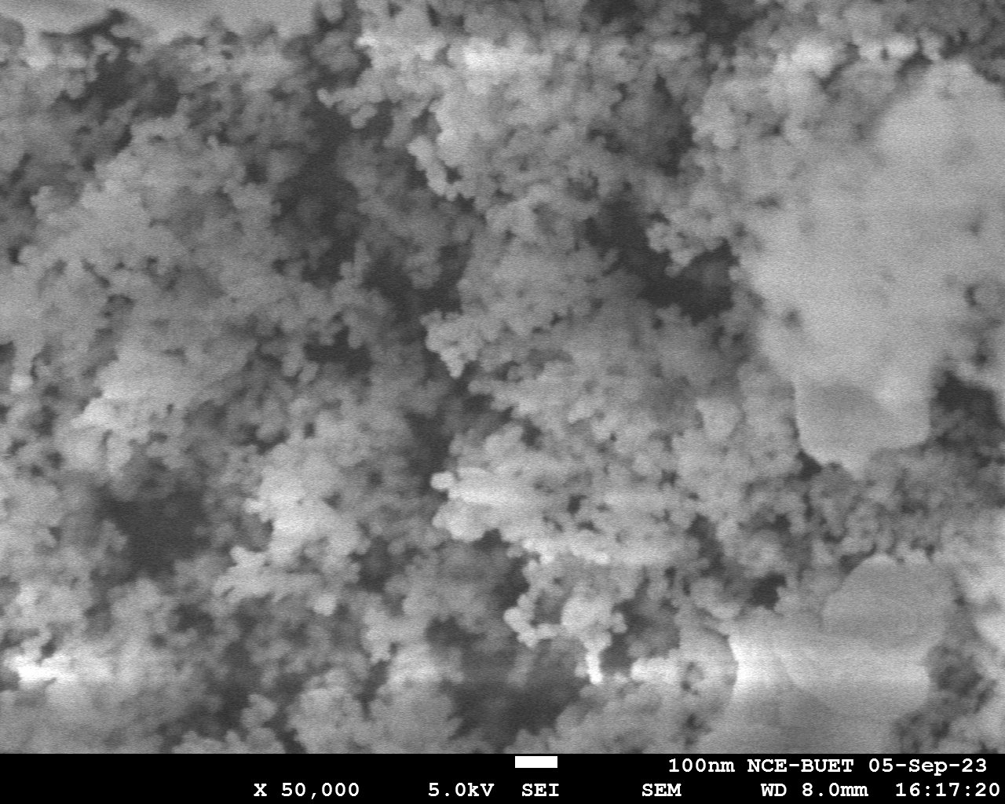
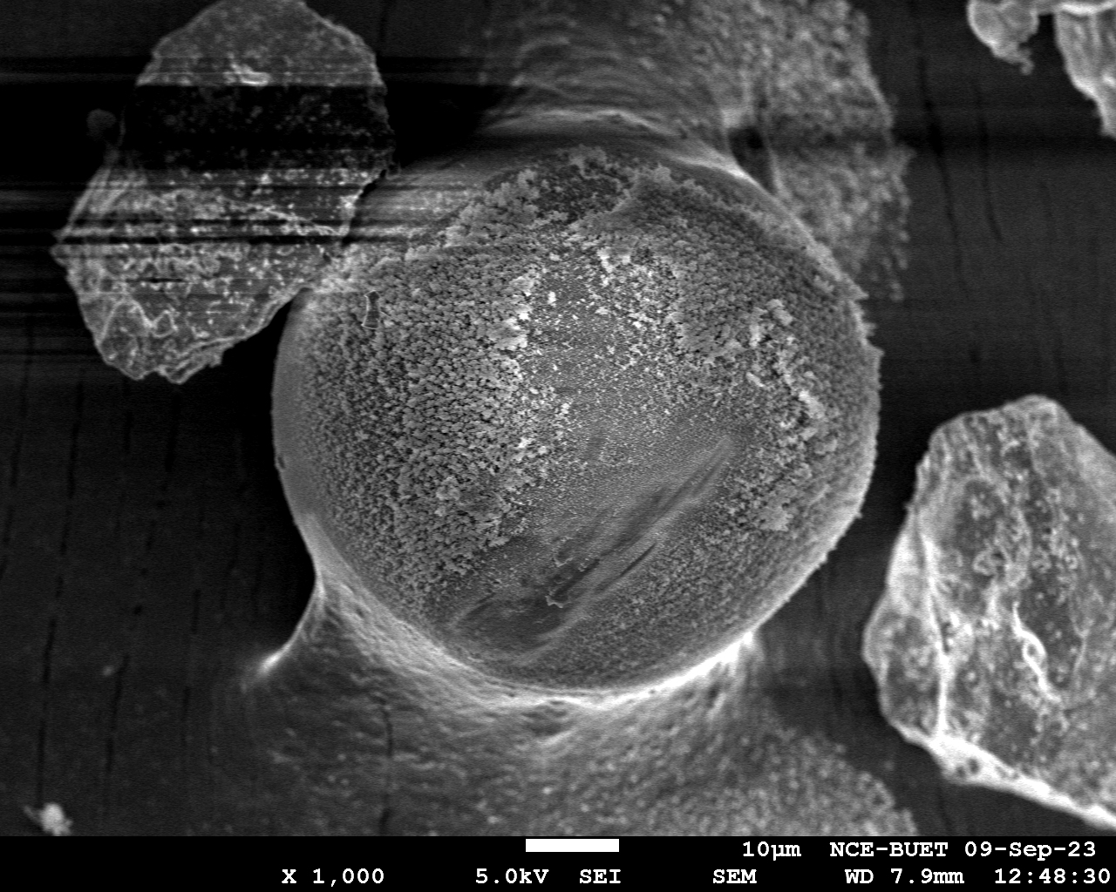
70um

Slide 19
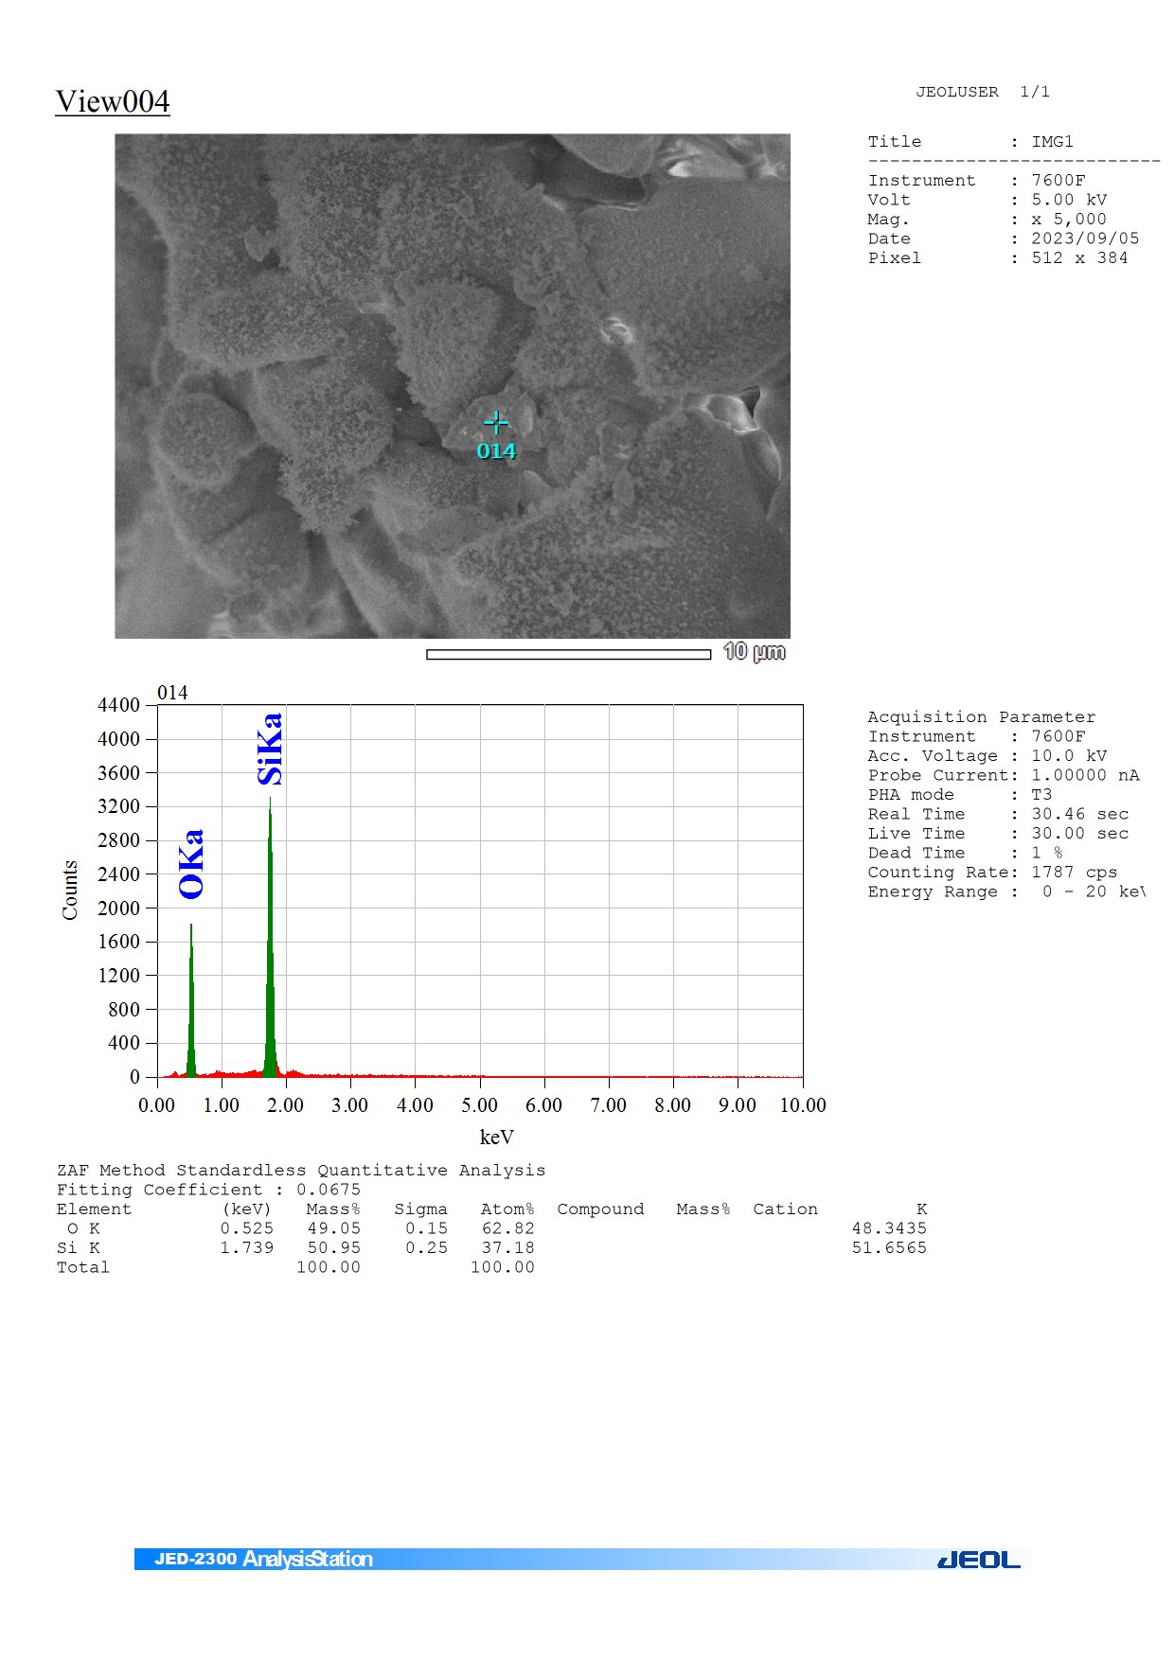
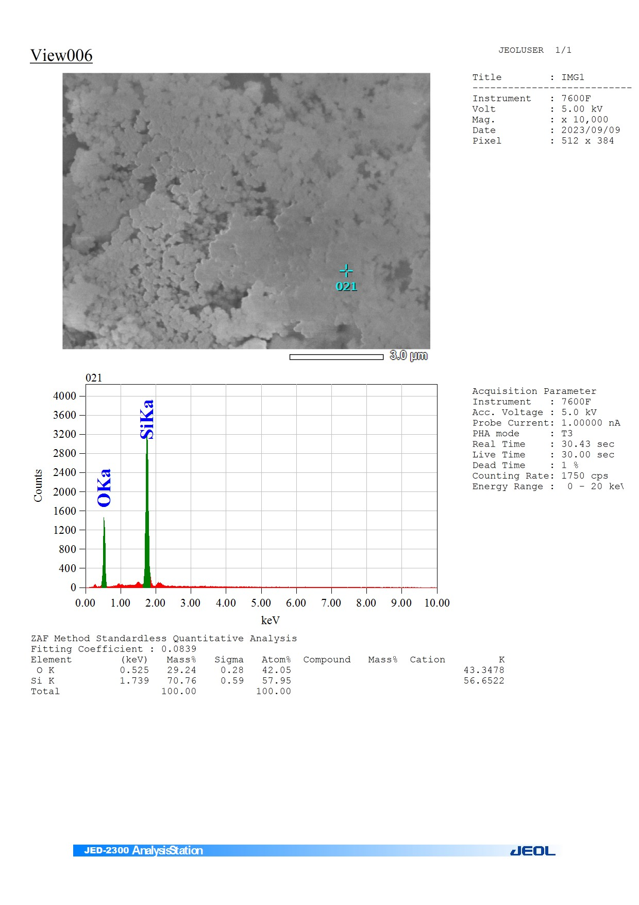


Slide 20
Test Day: 10th Sep,2023

Slide 21
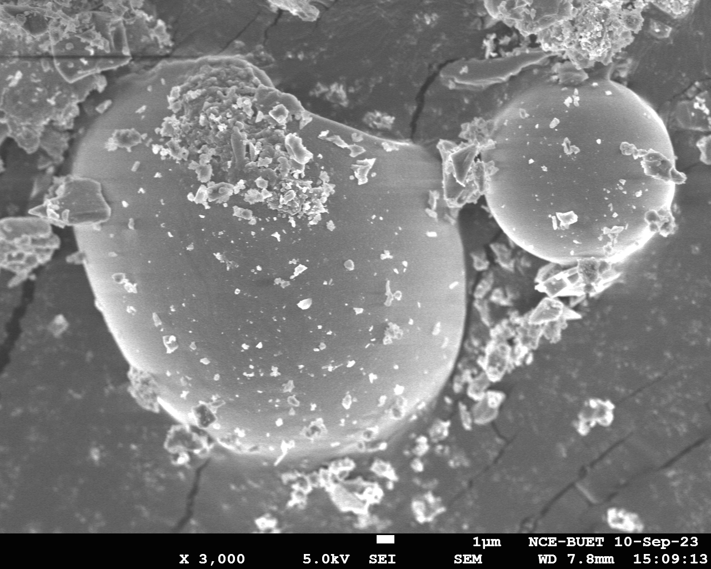
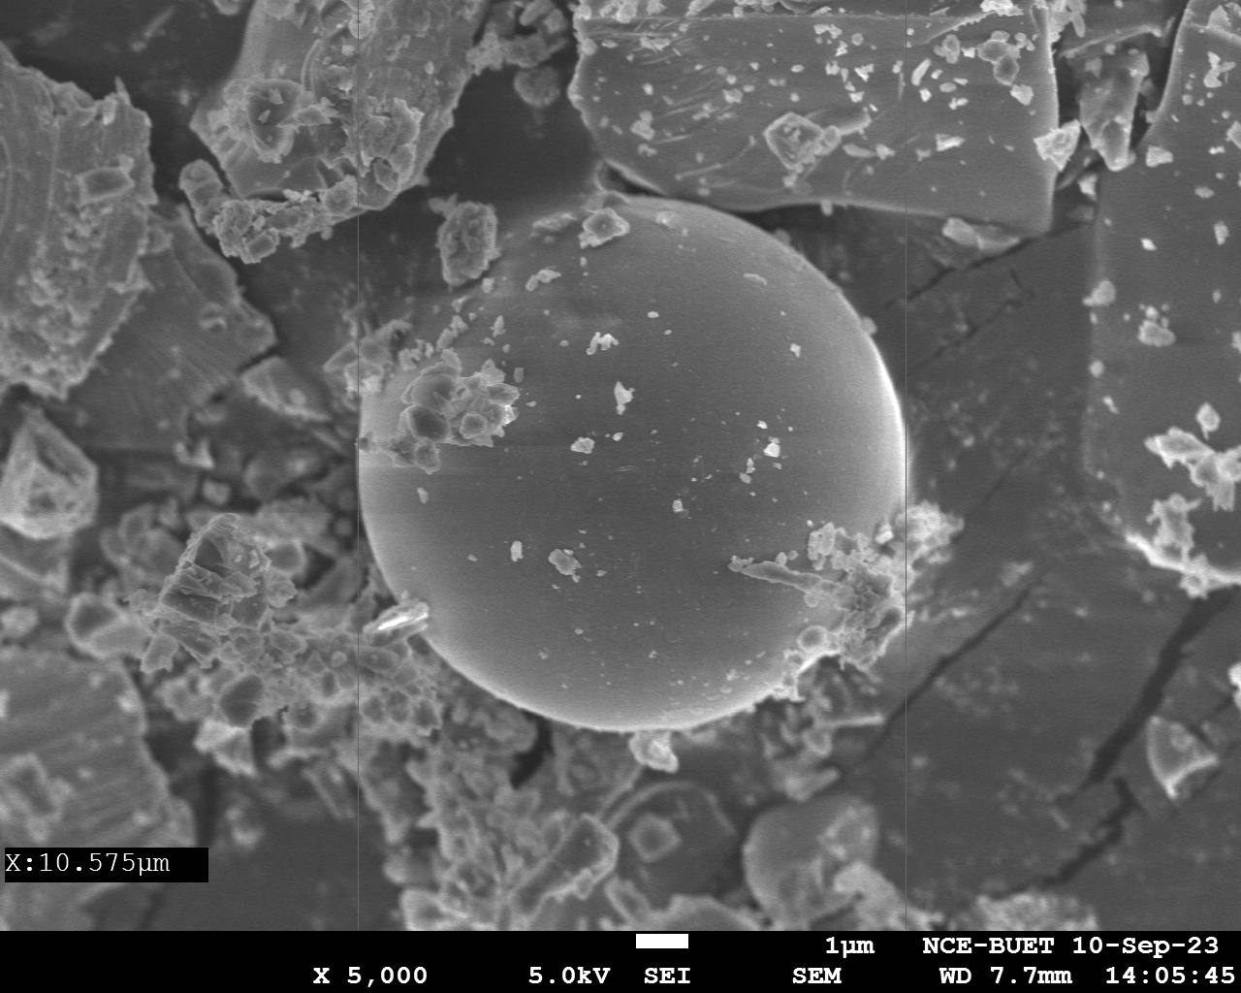
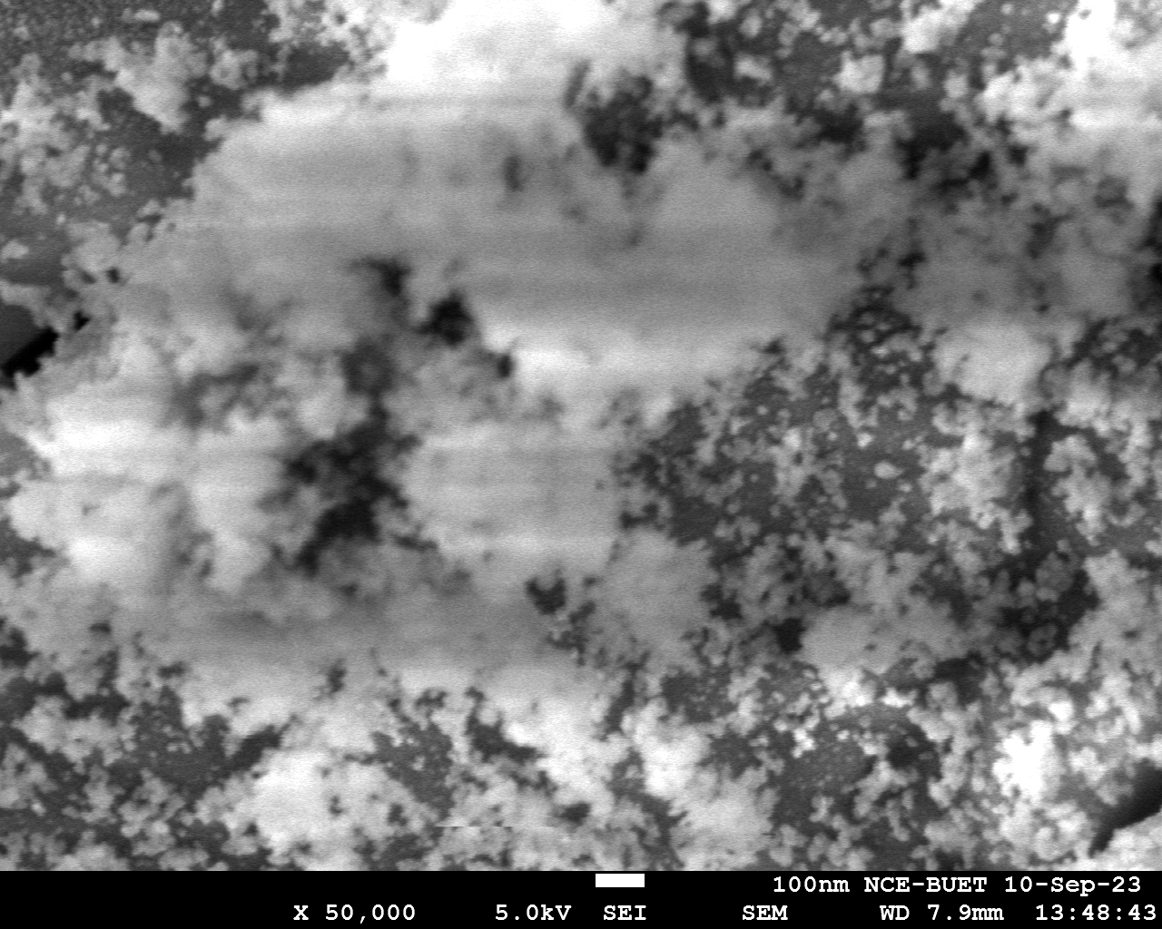
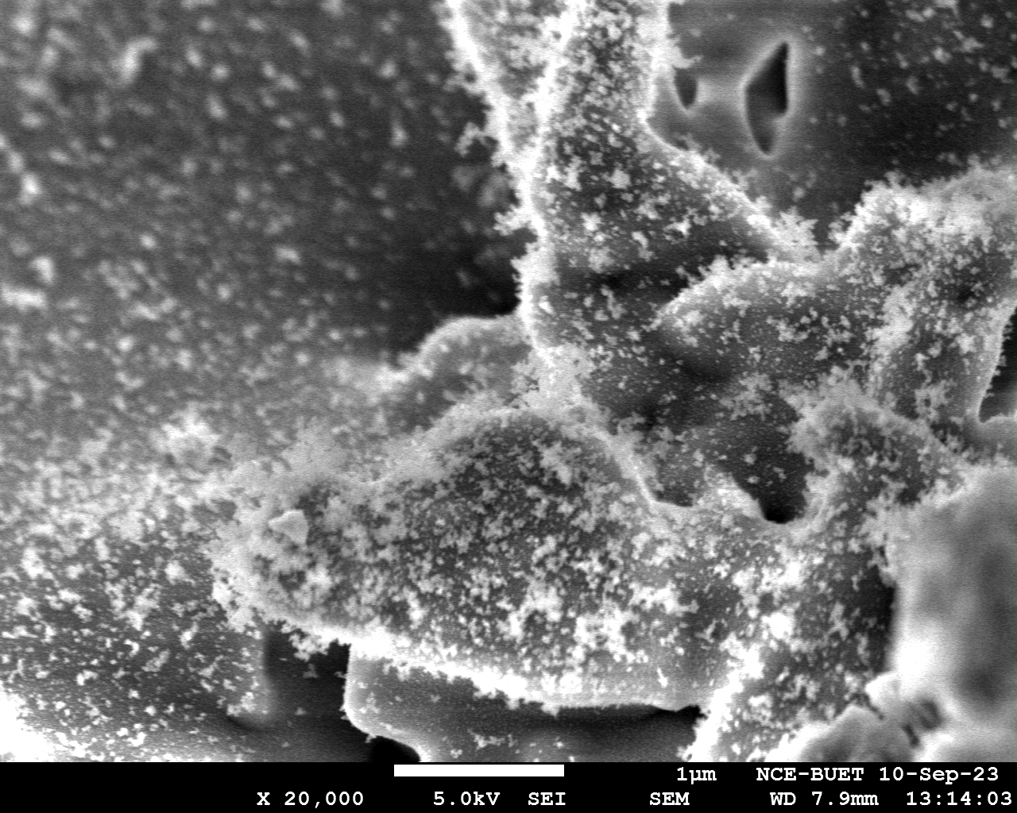
12um

Slide 22
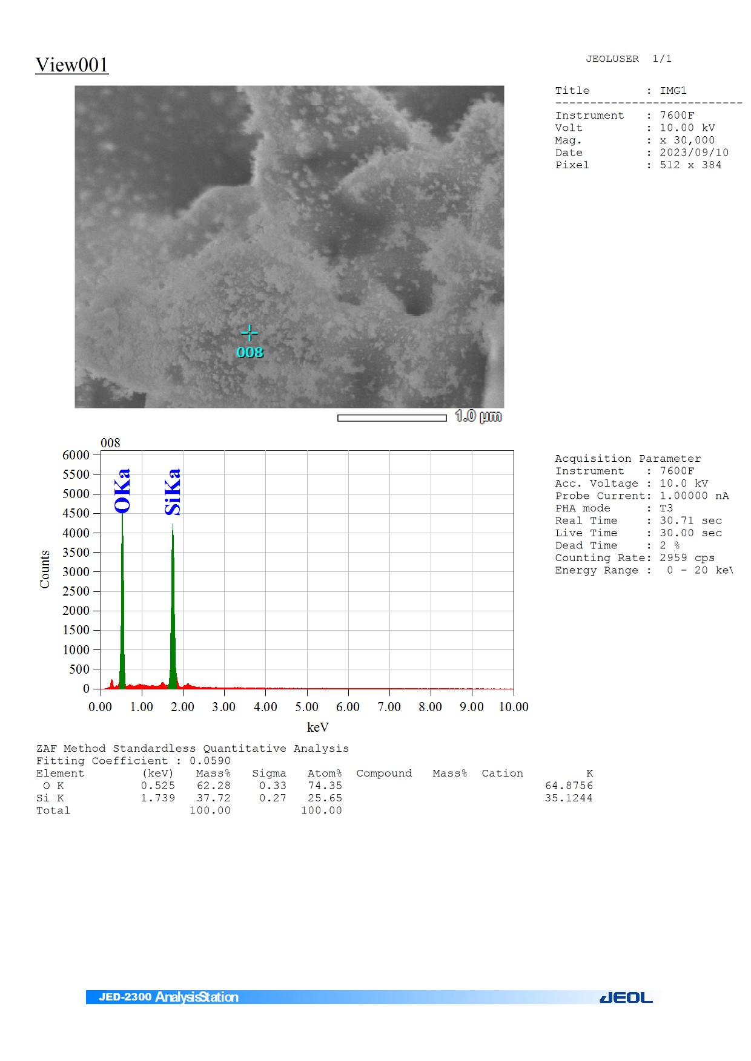
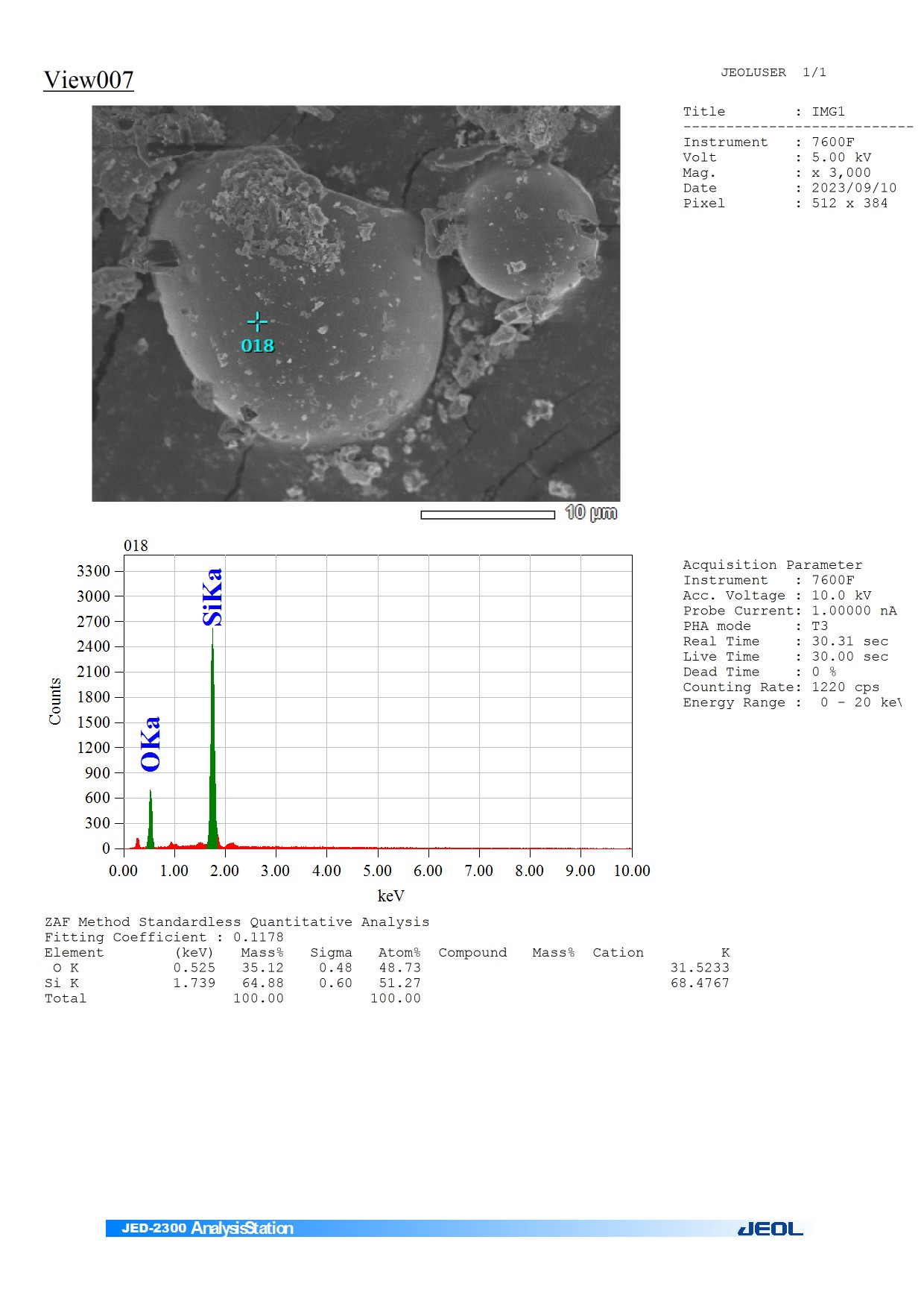

Slide 23
Test Day: 25th Sep, 2023

Slide 24
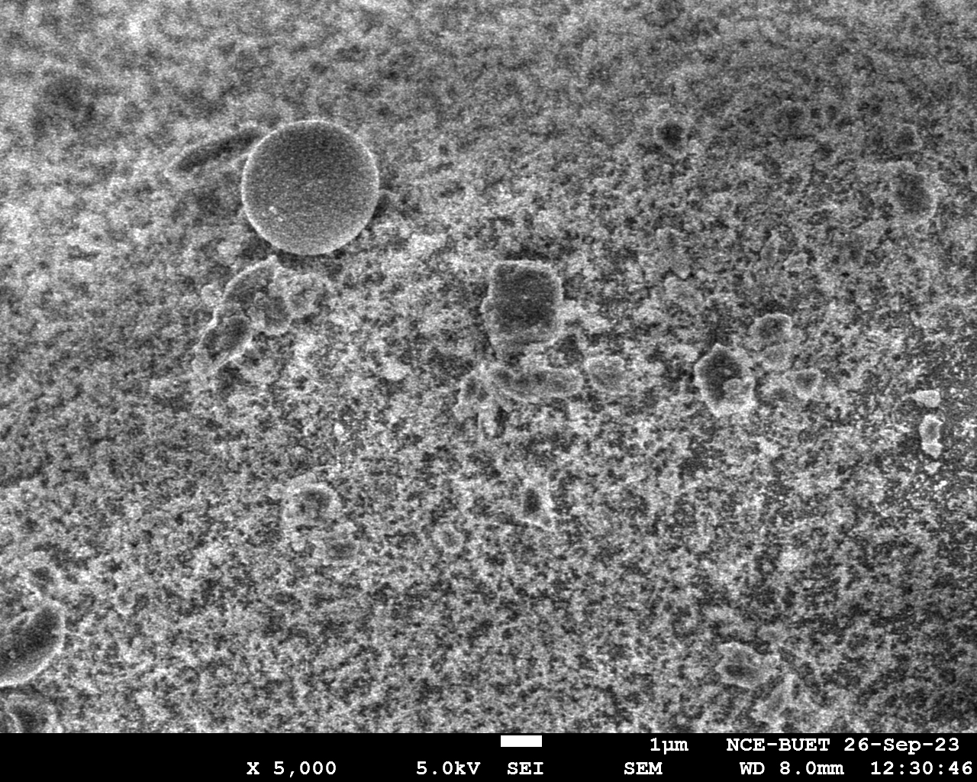
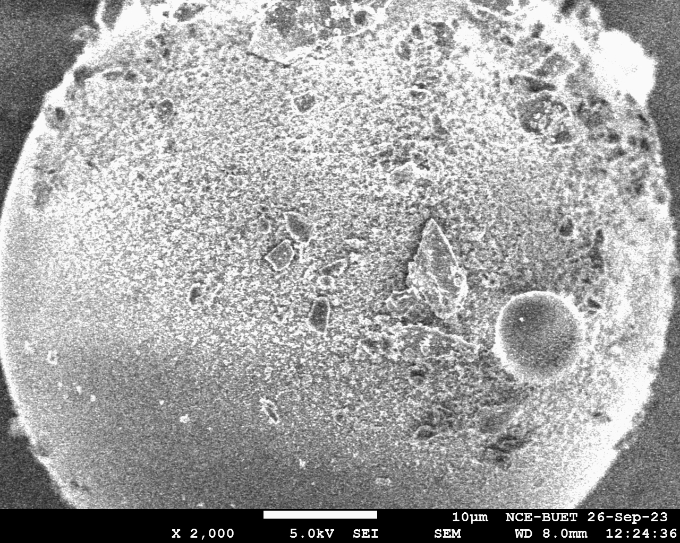
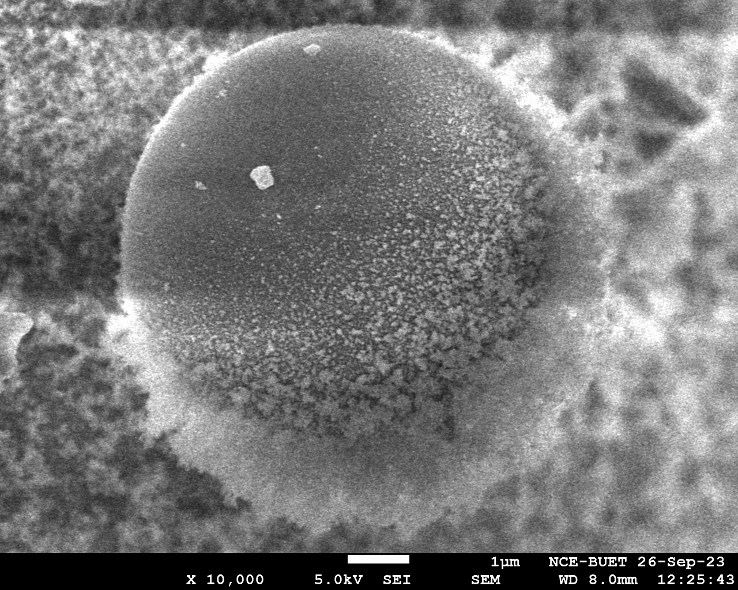
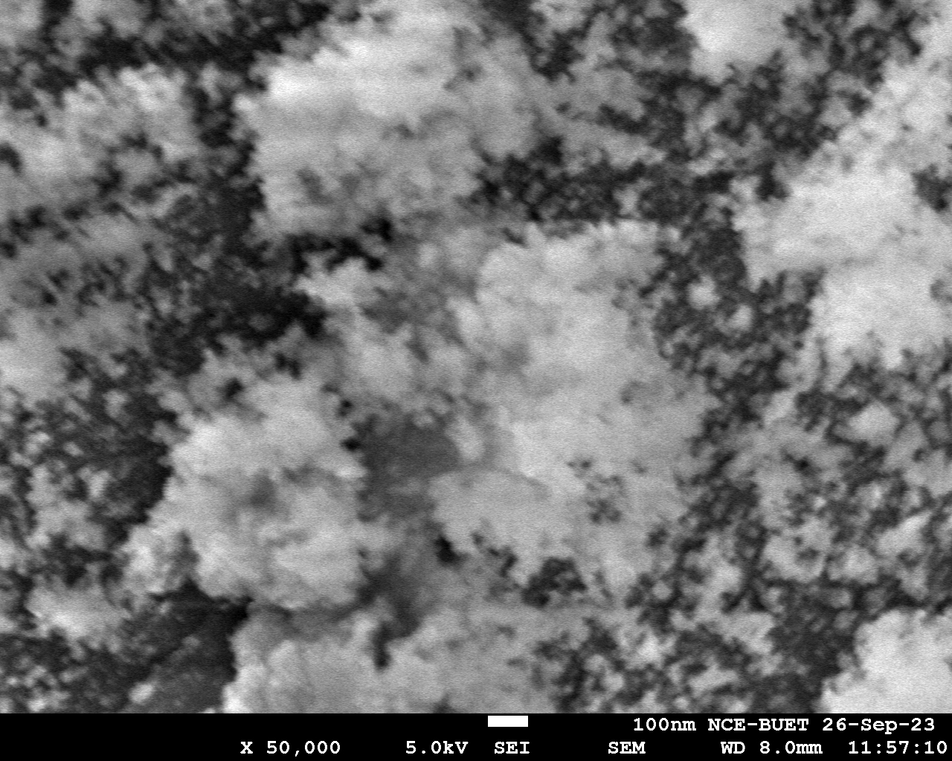

Slide 25
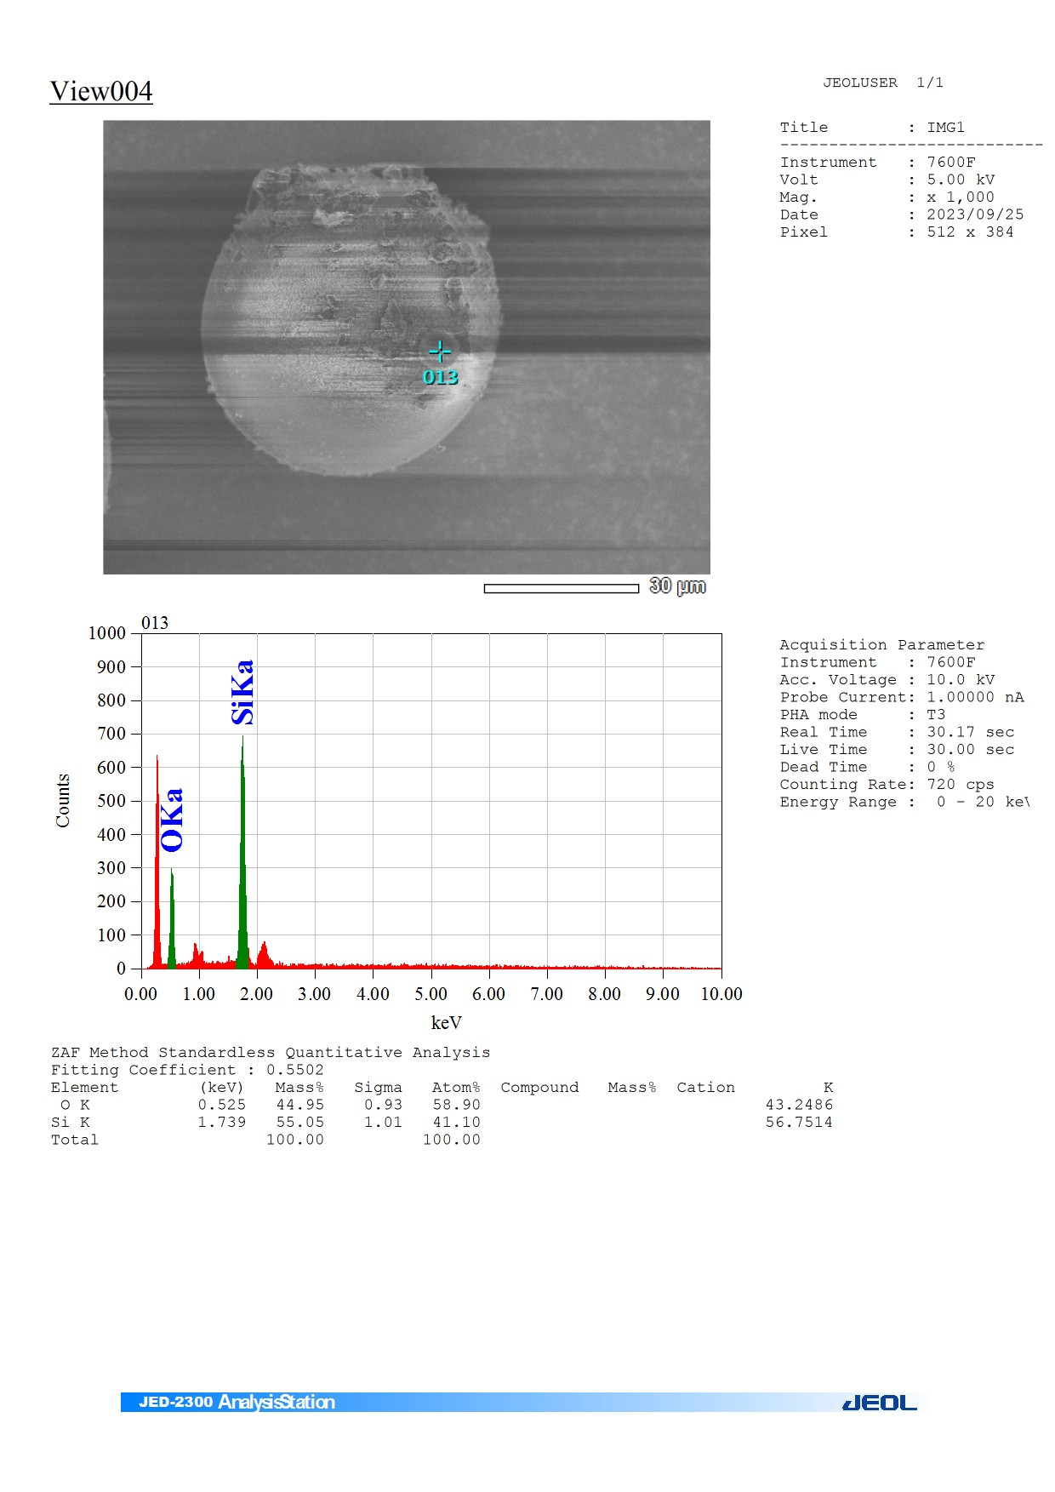
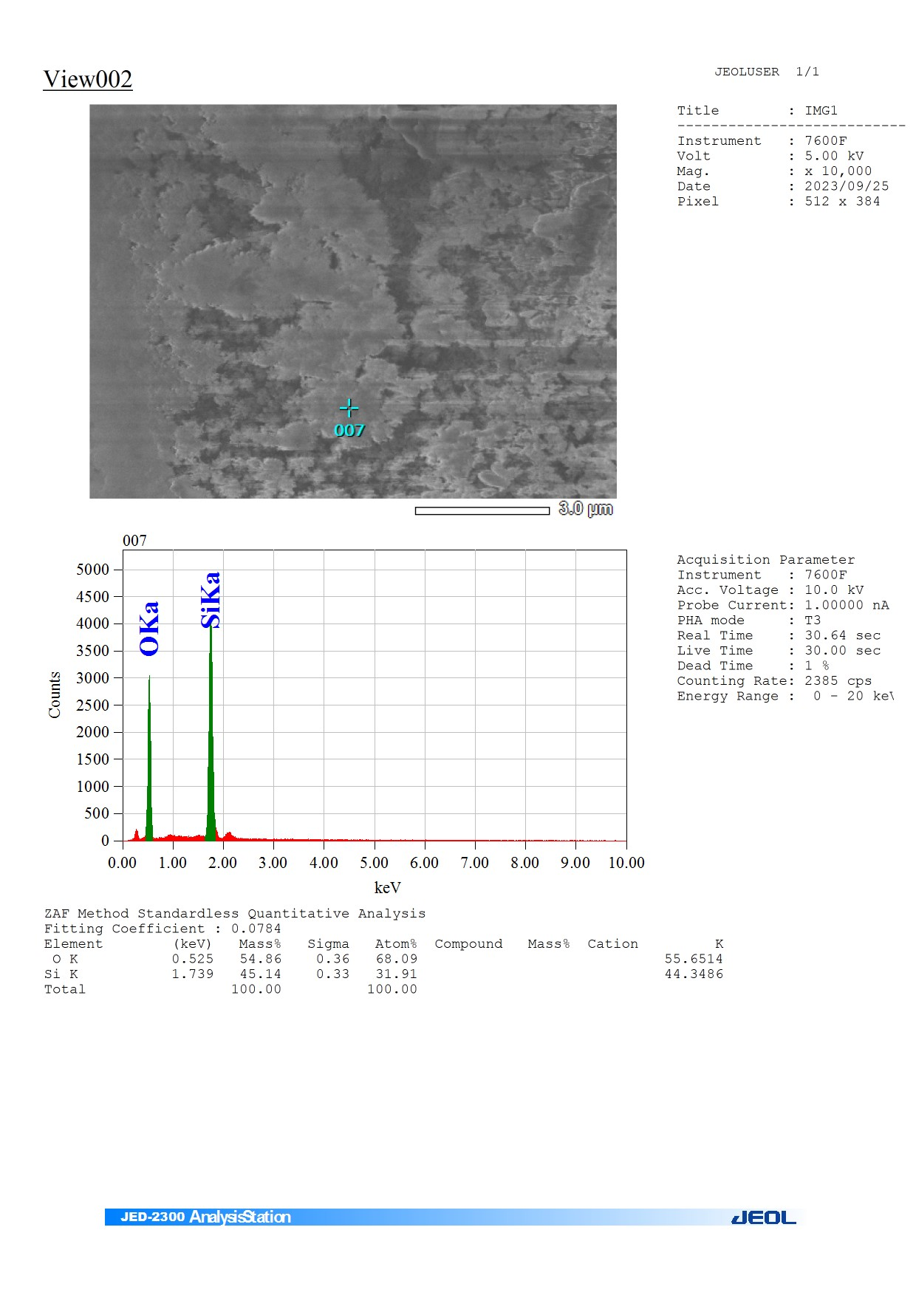

Slide 26
Test Day: 2nd Oct,2023

Slide 27
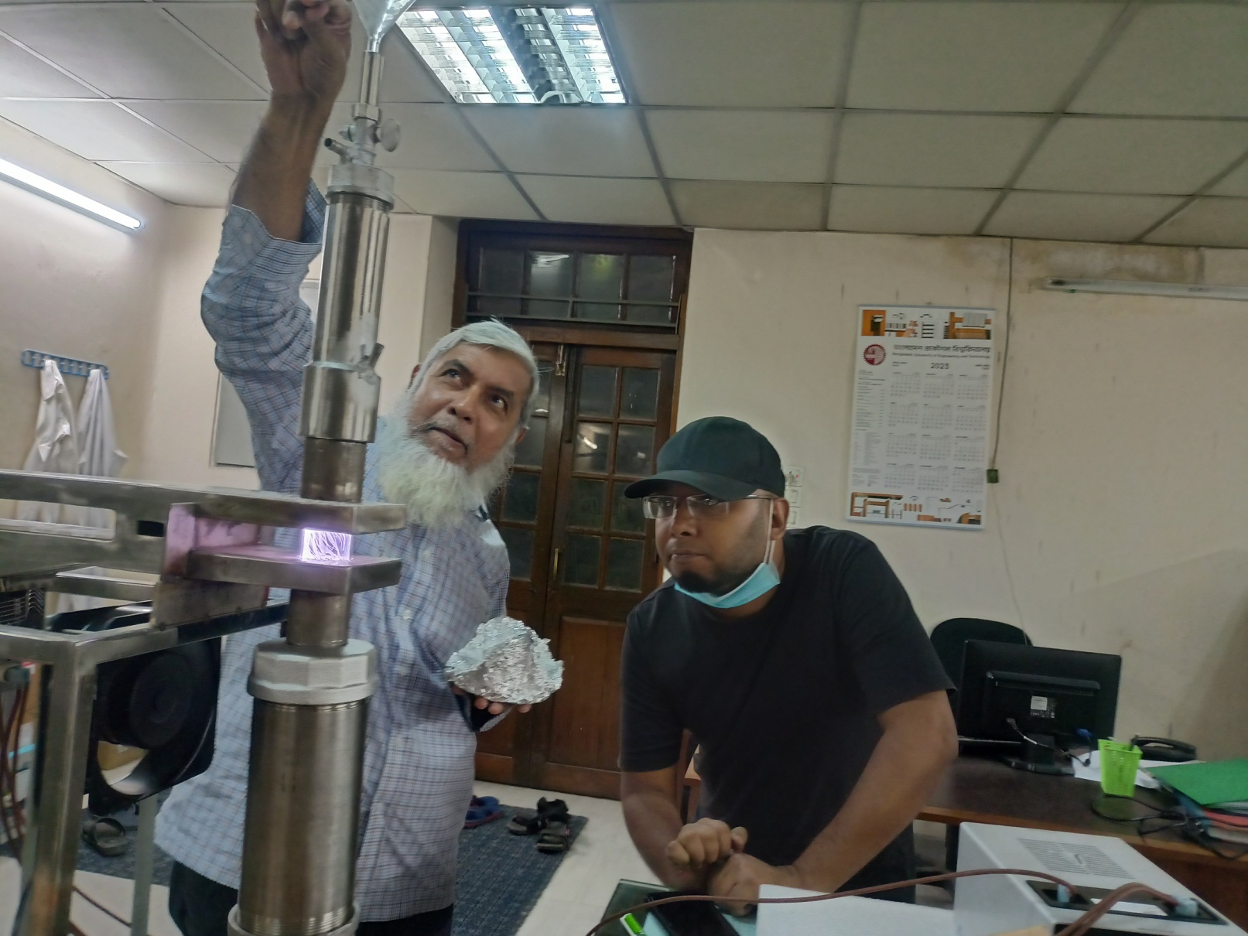
Sample + gas outlet
Idea: to form fluidized bed near plasma chamber
Gas Inlet

Slide 28
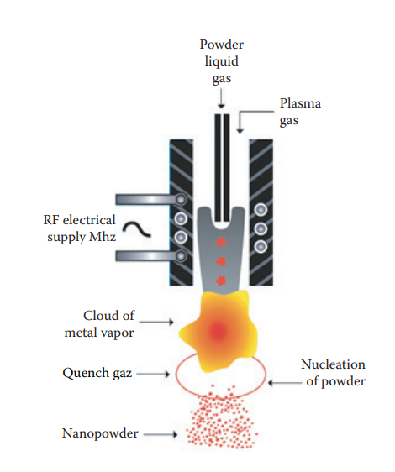
New Idea
Sample injecting pipe
Plasma Chamber
Quartz Tube: 28-32 mm

Slide 29
Thank You

